Slide 1

Objectives
In this session, you will learn to:
  Declare and create arrays of primitive, class, or array types
  Explain how to initialize the elements of an array
  Determine the number of elements in an array
  Create a multidimensional array
  Write code to copy array values from one array to another
  Define inheritance, polymorphism, overloading, overriding, and virtual method invocation
  Define heterogeneous collections

Slide 2
Arrays
Declaring Arrays:
  Group data objects of the same type.
  An array is an object.
  Declare arrays of primitive or class types:
    char s[ ];
    Point p[ ];
    char[ ] s;
    Point[ ] p;
  The declaration of an array creates space for a reference.
  Actual memory allocation is done dynamically either by a new statement or by an array initializer.

Slide 3
Creating Arrays
In order to create an array object:
  Use the new keyword
  An example to create and initialize a primitive (char) array:
    public char[] createArray()
    {
    char[] s;
    s = new char[26];
    for ( int i=0; i<26; i++ )
    {
    s[i] = (char) (’A’ + i);
    }
    return s;
    }

Slide 4
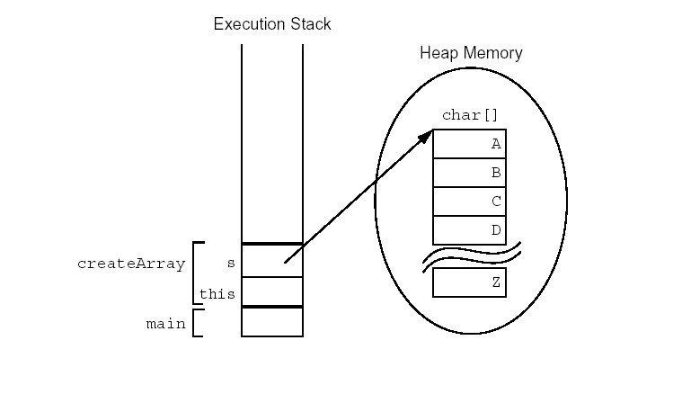
Creating Arrays (Contd.)
Creating an Array of Character Primitives:

Slide 5
Creating Reference Arrays
The following code snippet creates an array of 10 references of type Point:
public Point[] createArray()
{
Point[] p;
p = new Point[10];
for ( int i=0; i<10; i++ )
{
p[i] = new Point(i, i+1);
}
return p;
}

Slide 6
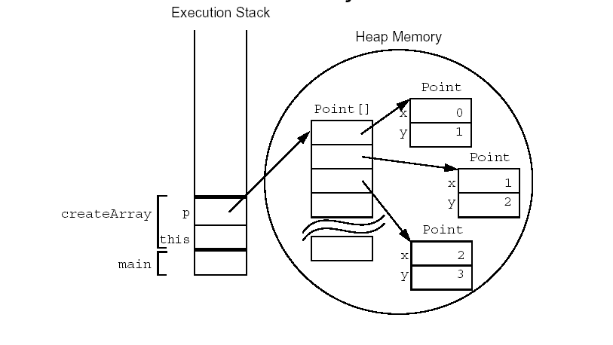
Creating Reference Arrays (Contd.)
Creating an Array of Character Primitives with Point Objects:

Slide 7
Demonstration
Lets see how to declare, create, and manipulate an array of reference type elements.

Slide 8
Multidimensional Arrays
A Multidimensional array is an array of arrays.
For example:
  int [] [] twoDim = new int [4] [];
  twoDim[0] = new int [5];
  twoDim[1] = new int[5];
  The first call to new creates an object, an array that contains four elements. Each element is a null reference to an element of type array of int.
  Each element must be initialized separately so that each element points to its array.

Slide 9
Array Bounds
All array subscripts begin at 0.
The number of elements in an array is stored as part of the array object in the length attribute.
The following code uses the length attribute to iterate on an array:
  public void printElements(int[] list)
{
for (int i = 0; i < list.length; i++) {
System.out.println(list[i]);
  }
}

Slide 10
The Enhanced for Loop
Java 2 Platform, Standard Edition (J2SE™) version 5.0 has introduced an enhanced for loop for iterating over arrays:
  public void printElements(int[] list)
  {
  for ( int element : list )
  {
  System.out.println(element);
  }
  }
  The for loop can be read as for each element in list do.

Slide 11
Array Resizing
You cannot resize an array.
You can use the same reference variable to refer to an entirely new array, such as:
int[] myArray = new int[6];
myArray = new int[10];
  In the preceding case, the first array is effectively lost unless another reference to it is retained elsewhere.

Slide 12
Copying Arrays
The Java programming language provides a special method in the System class, arraycopy(), to copy arrays.
For example:
  int myarray[] = {1,2,3,4,5,6}; // original array
  int hold[] = {10,9,8,7,6,5,4,3,2,1}; // new larger array
  System.arraycopy(myarray,0,hold,0,
  myarray.length); // copy all of the myarray array to the hold array, starting with the 0th index
  The contents of the array hold will be : 1,2,3,4,5,6,4,3,2,1.
  The System.arraycopy() method copies references, not
  objects, when dealing with array of objects.

Slide 13
Inheritance
Inheritance means that a class derives a set of attributes and related behavior from a parent class.
Benefits of Inheritance:
  Reduces redundancy in code
  Code can be easily maintained
  Extends the functionality of an existing class

Slide 14
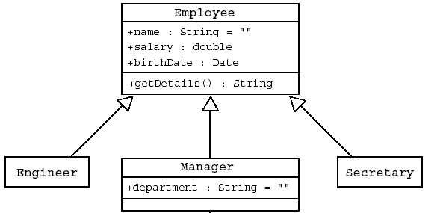
Inheritance (Contd.)
Single Inheritance
  The subclasses are derived from one super class.
  An example of single inheritance is as follows:

Slide 15
Inheritance (Contd.)
Java does not support multiple inheritance.
Interfaces provide the benefits of multiple inheritance without drawbacks.
Syntax of a Java class in order to implement inheritance is as follows:
  <modifier> class <name> [extends superclass>]
  { <declaration>* }

Slide 16
Access Control
Variables and methods can be at one of the following four access levels:
  public
  protected
  default
  private
Classes can be at the public or default levels.
The default accessibility (if not specified explicitly), is
package-friendly or package-private.

Slide 17
Overriding Methods
A subclass can modify behavior inherited from a parent class.
Overridden methods cannot be less accessible.
A subclass can create a method with different functionality than the parent’s method but with the same:
  Name
  Return type
  Argument list

Slide 18
Overriding Methods (Contd.)
A subclass method may invoke a superclass method using the super keyword:
  The keyword super is used in a class to refer to its superclass.
  The keyword super is used to refer to the members of superclass, both data attributes and methods.
  Behavior invoked does not have to be in the superclass; it can be further up in the hierarchy.

Slide 19
Overriding Methods (Contd.)
Invoking Overridden Methods using super keyword:
public class Employee
{
private String name;
  private double salary;
  private Date birthDate;
  public String getDetails()
  {
  return "Name: " + name + "\nSalary: “ + salary;
  }
  }

Slide 20
Overriding Methods (Contd.)
  public class Manager extends Employee
  {
  private String department;
  public String getDetails() {
  // call parent method
  return super.getDetails()
  + “\nDepartment: " + department;
  }
  }

Slide 21
Demonstration
Lets see how to create subclasses and call the constructor of the base class.

Slide 22
Polymorphism
Polymorphism is the ability to have many different forms; for example, the Manager class has access to methods from Employee class.
  An object has only one form.
  A reference variable can refer to objects of different forms.
  Java programming language permits you to refer to an object with a variable of one of the parent class types.
  For example:
  Employee e = new Manager(); // legal

Slide 23
Virtual Method Invocation
Virtual method invocation is performed as follows:
Employee e = new Manager();
e.getDetails();
  Compile-time type and runtime type invocations have the following characteristics:
    The method name must be a member of the declared variable type; in this case Employee has a method called getDetails.
    The method implementation used is based on the runtime object’s type; in this case the Manager class has an implementation of the getDetails method.

Slide 24
Heterogeneous Collections
Heterogeneous Collections:
  Collections of objects with the same class type are called homogeneous collections. For example:
    MyDate[] dates = new MyDate[2];
    dates[0] = new MyDate(22, 12, 1964);
    dates[1] = new MyDate(22, 7, 1964);
  Collections of objects with different class types are called heterogeneous collections. For example:
    Employee [] staff = new Employee[1024];
    staff[0] = new Manager();
    staff[1] = new Employee();
    staff[2] = new Engineer();

Slide 25
Summary
In this session, you learned that:
  Arrays are objects used to group data objects of the same type. Arrays can be of primitive or class type.
  Arrays can be created by using the keyword new.
  A multidimensional array is an array of arrays.
  All array indices begin at 0. The number of elements in an array is stored as part of the array object in the length attribute.
  An array once created can not be resized. However the same reference variable can be used to refer to an entirely new array.
  The Java programming language permits a class to extend one other class i.e, single inheritance.

Slide 26
Summary (Contd.)
  Variables and methods can be at one of the four access levels: public, protected, default, or private.
  Classes can be at the public or default level.
  The existing behavior of a base class can be modified by overriding the methods of the base class.
  A subclass method may invoke a superclass method using the super keyword.
  Polymorphism is the ability to have many different forms; for example, the Manager class (derived) has the access to methods from Employee class (base).
  Collections of objects with different class types are called heterogeneous collections.

